Slide 1


Credit Card Fraud Detection by Using Machine Learning and ANN FITSUM DESALEGN f72@umbc.edu https://github.com/fitsum99/UMBC-Data606.git

Slide 2
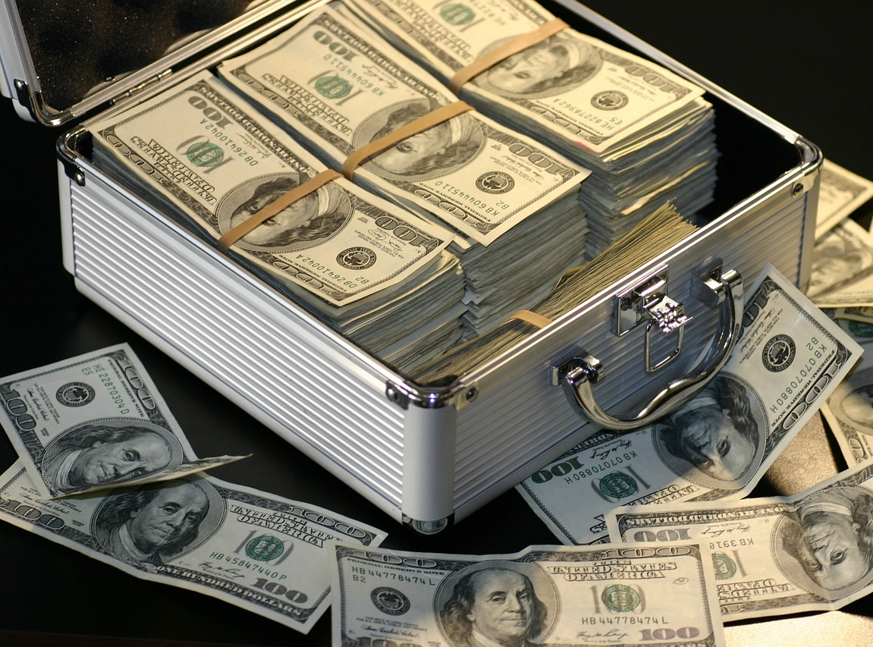
Introduction and literature
Fraud is one of the major ethical issues in the credit card industry.
Saving people income from any fraudulent activity is one of the most important things in the present day.
This model detecting whether the transaction is fraud or not that can help in saving a vast amount of money and security.
The project will be a chance for me to perform and apply data mining analysis on real-world credit cards datasets.
This Photo by Unknown Author is licensed under CC BY-ND

Slide 3
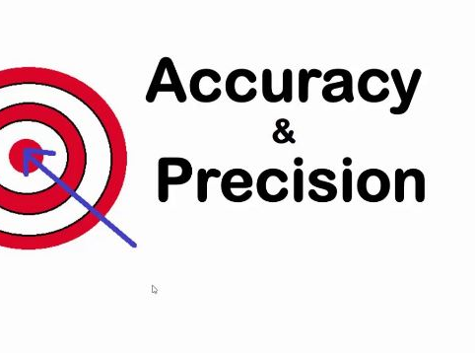
Objective
Find out how to execute machine learning and AI-based on financial datasets.
Analyze the best accuracy result before the transaction is approved.

Slide 4
Data Sources
The data gathered for this project was collected from the Kaggle web site, which was saved in CSV format.
(https://www.kaggle.com/mlg-ulb/creditcardfraud).
The aim is to discover the false request from the total (284,807) transactions.
The datasets are exceptionally unequal, the positive category (fraud) represent zero.
This data contains only numerical input variables that area unit the results of principle component analysis transformation.
There is no any missing value in the dataset.
Also the CSV data contain 28V row and 284808 columns.

Slide 5
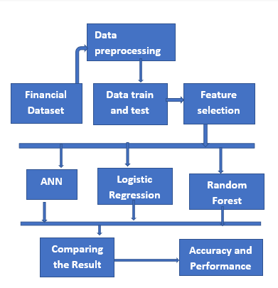
Methodology
To fulfil the goal I have implemented the following methods for the project.
I proposed some detection technique to avoid the frauds is the artificial neural network, Logistic regression and Random Forest.
Here is the deal with an unbalanced dataset and the system will tell about the fraudulent over nonfraudulent transactions.
It gives better performance to detect the fraud

Slide 6
…??? f72@umbc.edu
Thank you for your attention!!!

